Slide 1
The Battle of Neighbourhood
--Siddhant Bhandarkar

Slide 2
Introduction:
The main objective of this project is to help people in exploring better facilities around their neighborhood. It will help people in making a smart and efficient decision on choosing excellent neighborhoods out of numbers of other neighborhoods in Scarborough, Toronto.
Many people are migrating too many different states of Canada and need a lot of research for sound housing prices and reputed schools for their children. This project is for those people who are looking for better neighborhoods. For ease of accessing to Cafe, School, Supermarket, medical shops, grocery shops, mall, theatre, hospital, like-minded people, etc.
This project intends to create an analysis of features for people who are migrating to Scarborough in search of the best neighborhood as a relative analysis between neighborhoods.
It will help people to get the awareness of the area and neighborhood before moving to a new city, state, country or place for their work or to start a new fresh life.

Slide 3
Problem :
The major goal of this project is to recommend a better neighborhood in a new city for the person who is moving there. Social presence in society in terms of like-minded people. Connectivity to the airport, bus stand, city center, markets and other daily needs things nearby.
Sorted list of the house in terms of housing prices in an ascending or descending order
Sorted list of schools in terms of location, fees, rating, and reviews

Slide 4
Location:
Scarborough is a favorite destination for new immigrants in Canada to reside in. As a result, it is one of the most distinct and multicultural areas in the Greater Toronto Area, being home to various religious groups and places of worship. Although immigration has become a hot topic over the past few years with more governments seeking more constraints on immigrants and refugees, the general trend of immigration into Canada has been one of the rises.
Foursquare API:
This project would use Four-square API as its prime data collecting source as it has a database of millions of places, notably their places API which provides the capacity to perform location search, location sharing and details about a business.

Slide 5
Data Description:
Data link: https://en.wikipedia.org/wiki/List_of_postal_codes_of_Canada:_M
Roursquare API Data:
We will need data about different venues in different neighborhoods of that specific borough. In order to gain that information we will use "Foursquare" locational information. Foursquare is a location data provider with information about all manner of venues and events within an area of interest. Such information includes venue names, locations, menus and even photos. As such, the foursquare location platform will be used as the sole data source since all the stated required information can be obtained through the API.
After finding the list of neighborhoods, we then connect to the Foursquare API to gather information about venues inside each and every neighborhood. For each neighborhood, we have chosen the radius to be 100 meter

Slide 6
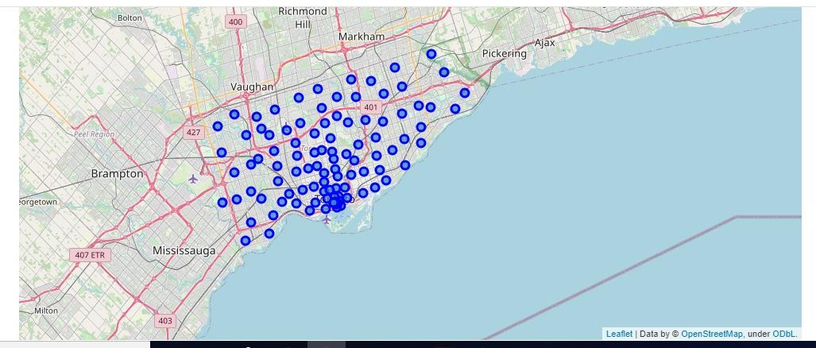
Methodology:
Map of Scarborough:
The Geographical Co-ordinate of Neighborhood_1 are 43.773077, - 79.257774.

Slide 7
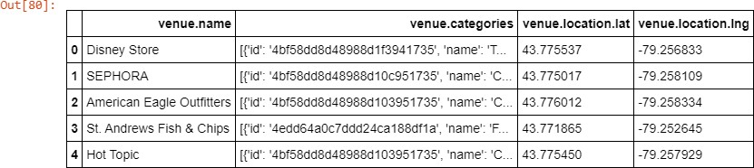
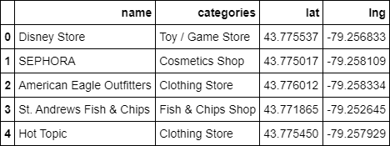
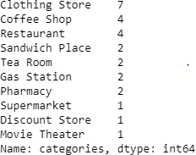
Nearby Venues/Locations:
Categories of Nearby Venues/Locations:

Slide 8
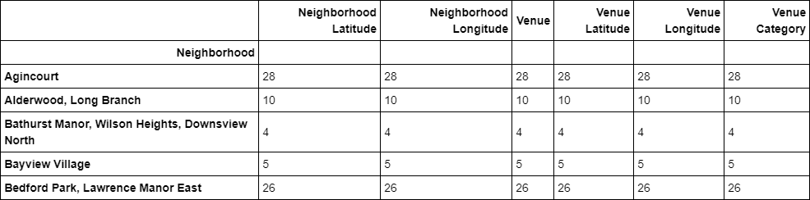
Total Count:

Slide 9
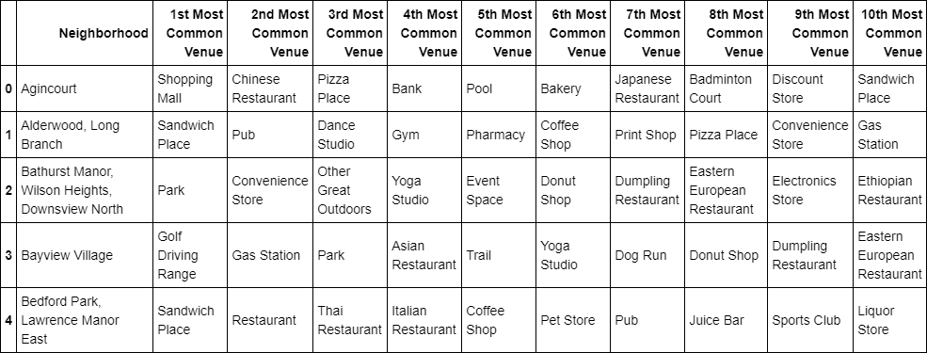
Results:
Most Common venues near neighborhood:

Slide 10
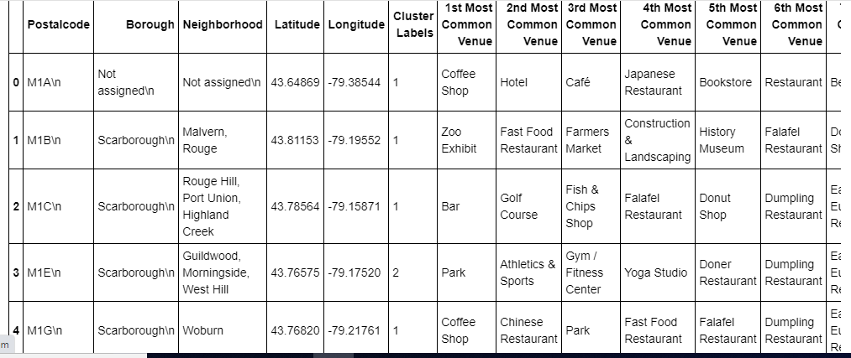
Clustering approach:

Slide 11
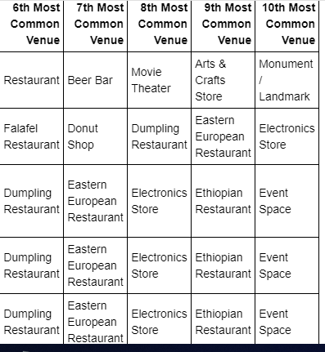

Slide 12
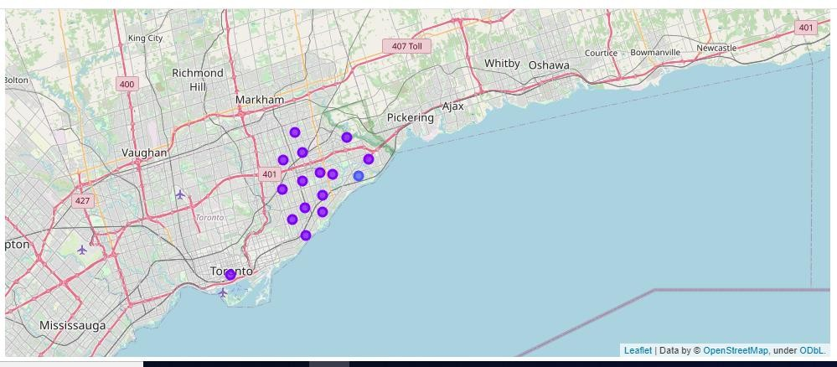
Maps of clustering:

Slide 13
Conclusion:
In this project, using k-means cluster algorithm I separated the neighborhood into 10(Ten) different clusters and for 103 different lattitude and logitude from dataset, which have very-similar neighborhoods around them. Using the charts above results presented to a particular neighborhood based on average house prices and school rating have been made.

Slide 14
Thank You

